Slide 1
Lecture 8
Para Virtualization
Full Virtualization

Slide 2
Understanding Paravirtualization and Full virtualization

Slide 3
OS Recap
In order to understand how a Para virtualization and Full virtualization works, we need to know how operating systems manage the underlying hardware
Think about a simple application task like browsing a website
If you want to browse a website, your browser application has to use the network card and it has to make a system call in order for that to occur

Slide 4
Some operating system components can directly access your hardware
In order to manage these different privilege levels, modern x86 CPUs have different execution privilege groups called rings
Each ring has different restrictions on the type of operations that can be performed by the CPU
For example, device drivers and the kernel usually run in Ring 0 which grants the highest permission level, while user applications always run in the least privilege ring

Slide 5
This also applies to virtual machine themselves. Virtual machines require an operating system and this OS requires Ring 0 authority
As a guest OS unable to access Ring 0 directly, it must obtain Ring 0 privilege
Hypervisors usually solve this problem with either Para or Full Virtualization.

Slide 6
Para virtualization
In the Para virtualization method when a privilege command must be executed on the Guest OS
it is delivered to the hypervisor through a hypercall, a kind of system call
When the hypervisor receives this hypercall, it accesses the hardware and returns the result.

Slide 7
Para virtualization requires some modifications to the guest operating system kernel in order to use the hypercall mechanism.
Thanks to hypercalls, virtual machines applications and operating systems run in CPU Ring 3, the least privileged CPU mode.
Therefor a guest OS is recompiled prior to installation inside a virtual machine. In para-virtualization, the guest OS is modified to enable communication with the hypervisor to improve performance and efficiency.
As paravirtualization cannot support unmodified operating sys (e.g. Windows 2000/XP), its compatibility and portability is poor
VMware and Xen are supported by this type of virtualization.

Slide 8
Full Virtualization
In full virtualization the idea is to leave the operating system pretty much unmodified so you can run the guest operating system on top of the hypervisor, as it will run natively on the real hardware
This is called full virtualization because the operating system is completely untouched.
Nothing has been changed. Not even a single line of code is modified in these operating systems in order to run on the hypervisor simultaneously.

Slide 9
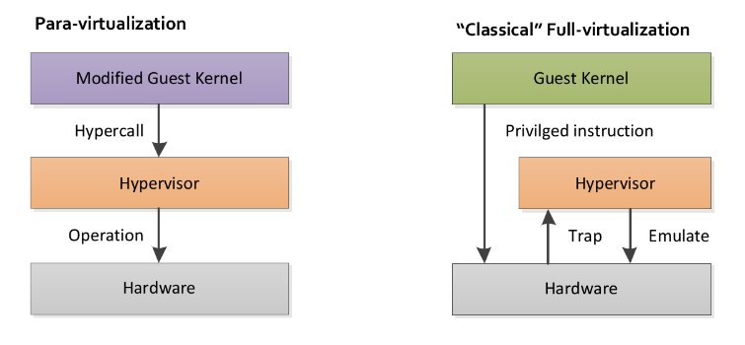

Slide 10
The Trap and Emulate Strategy
Operating systems running on top of the hypervisor are run as user-level processes. They are not running at the same level of privilege as a host operating system that is running on bare metal as though running in ring 0 of the CPU.
But if the operating system code is unchanged, it doesn’t know that it does not have the privilege for doing certain things that it would do normally on bare metal hardware.

Slide 11
In other words, when the operating system executes some privileged instructions, meaning they have to be in a privileged mode or kernel mode to run on bare metal in order to execute those instructions
Those instructions will create a trap that goes into the hypervisor and the hypervisor will then emulate the intended functionality of the operating system.
This is what is called the trap and emulate strategy.

Slide 12
Trap and Emulate Strategy contd
Attempting a privileged instruction when in user mode causes an error to occur thus leading to trap state.
And after this the VMM (Virtual Machine Manager) gets control and analyzed the error , executes the operation as attempted by the guest and then return the control back to guest in user mode.
Note : Kernel mode privileged command runs slower due to trap and emulate

Slide 13
The guest operating system makes system calls to the emulated hardware.
These calls, which would actually interact with underlying hardware, are intercepted by the virtualization hypervisor through “trap” which maps them onto the real underlying hardware.
The products support this virtualization are VMware, Microsoft, and KVM.

Slide 14
